Slide 1
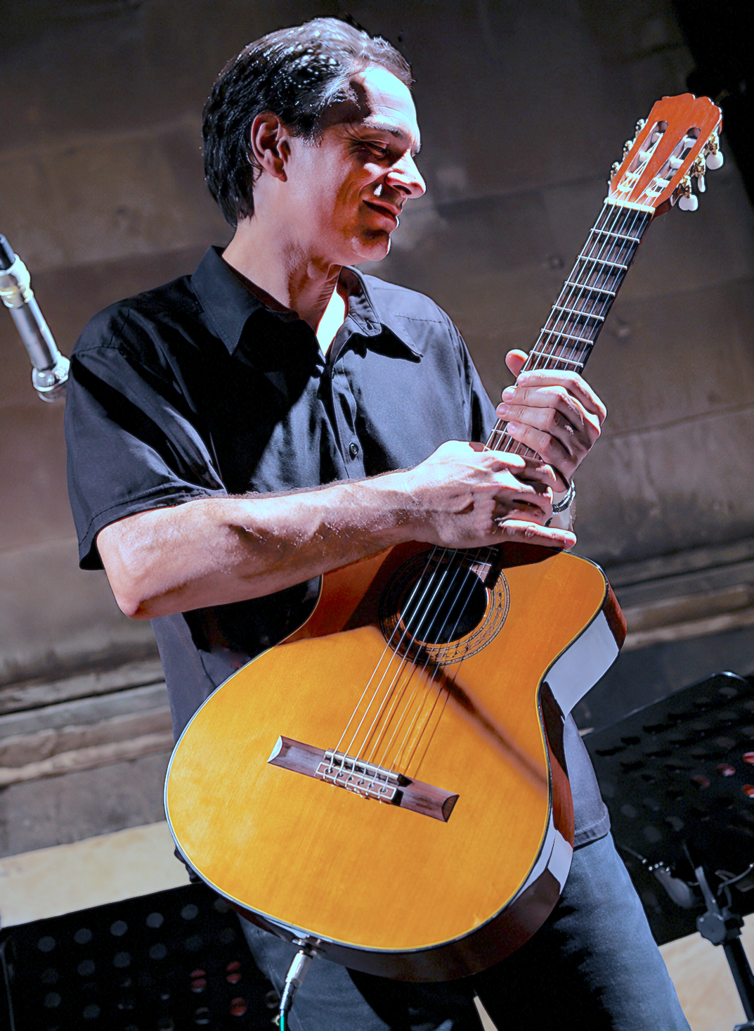
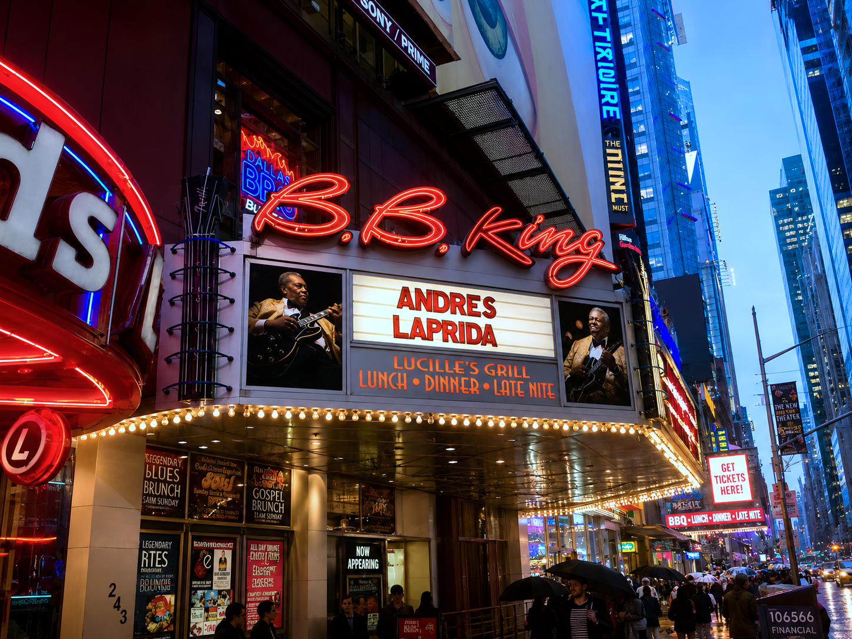
ANDRES LAPRIDA
ACOUSTIC & ELECTRONIC MUSIC PRODUCER – FILM SCORING / TV / THEATRE / ORCHESTRAL
ARTIST GUITAR PLAYER – BRAZILIAN JAZZ & TANGO / NEW AGE / CLASSICAL

Slide 2
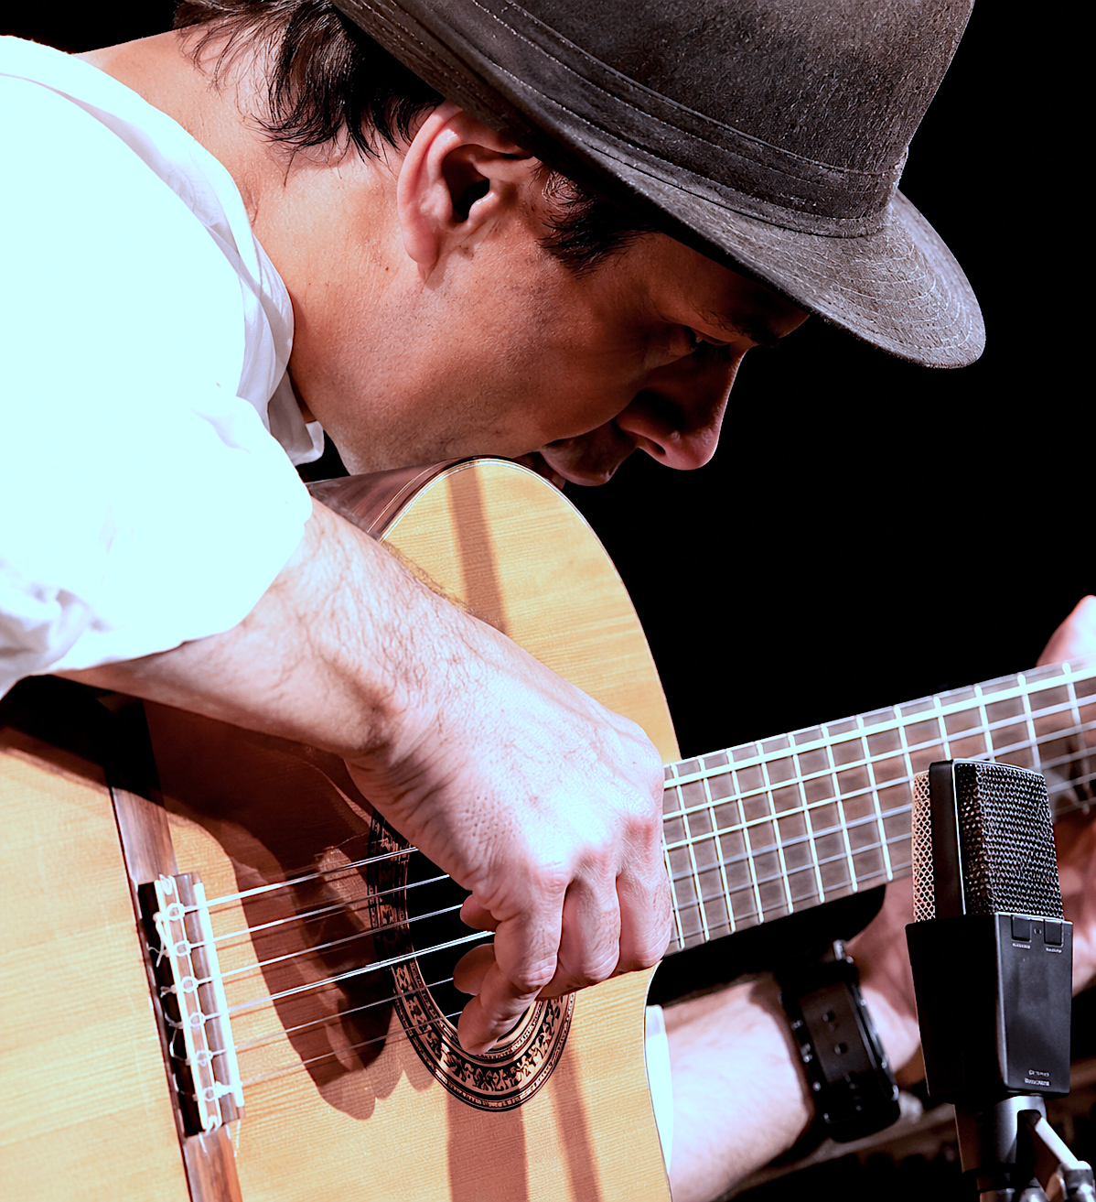
BIOGRAPHY
ANDRÉS LAPRIDA is a guitarist/composer from Argentina, who has achieved a remarkable exposure through a wide range of assignments. His prolific work as a performer, composer, and producer keeps earning a highly enthusiastic response from musicians, audience, and critics, ever since the great Brazilian music masters –Antonio Carlos Jobim, Vinicius de Moraes, and Toquinho introduced him to the public, at a very early age.
With a very personal sound and technique, Mr. Laprida has taken his music around the world in a variety of contexts —concert halls, jazz festivals, theatre, music seminars, ballet, film, television, radio, and the recording industry.
Current live performances include “Brazilian Jazz & Tango – Tribute to Jobim & Piazzolla”, “Os Afrosambas – Tribute to Baden Powell & Vinicius de Moraes”, “Bésame Mucho – Latin Guitar Fest”, and “Girl From Ipanema: The Next Generation”.
Contact: aguamagica@gmail.com

Slide 3
CONCERTS
USA
The Blue Note, NYC
B.B. King, NYC
Café Wha?
Drom, NYC
The Highline Ballroom, NYC
The Village Vanguard, NYC
La Mama Theater, NYC
Birdland, NYC
The Rainbow Room, NYC
Tavern on the Green (Flamenco!), NYC
Subrosa, NYC
Nell’s, NYC
The Queens Library, NY
The Knitting Factory, NYC
Sweetwater’s, NYC
Hot Nights, Cool Sounds, NYC
Summer Fest, Fort Tryon Park, NYC
The Town Hall, NYC
The Metropolitan Museum, NYC
The Guggenheim Museum, NYC
Lee Strasberg Actor‘s Studio, NYC
La Belle Epoque, NYC
Lower Manhattan Concert for the Arts, NYC
Baruch College, NYC
University of Yale, Connecticut
The Blue Note Jazz Festival 2014, NYC
The Blue Note Jazz Festival 2015, NYC
The Blue Note Jazz Festival 2016, NYC
The Blue Note Jazz Festival 2017, NYC
Club Bonafide, NYC
City Winery, NYC
City Vineyard, NYC
FRANCE
La Madeleine Church, Paris
Notre Dame de Val de Grace, Paris
CANADA
The University of Guelph, Toronto
Silver Peso Club, Toronto
NORWAY
Sting (con Leo Sujatovich), Stavanger
Musikkhogskolen, Stavanger
BRAZIL
Teatro Latinoamericano, Sao Paulo
Teatro Tuca, Sao Paulo
Chiko’s Bar, Rio de Janeiro
Antonino’s Bar, Rio de Janeiro
ITALY
Etna Jazz, 2000 (Catania)
Mediterraneo Senza Frontera III, 2000 (Agrigento)
Catania Jazz, 2001 (Catania)
Adrano Jazz, 2002 (Adrano)
Club Della Stampa, 2002 (Catania)
Festa di Lapis, 2001 (Catania)
Naxos-Chitarre, 2001 (Giardini-Naxos)
La Giara, 2001 (Taormina)
Pegaso D’Oro, 2001 (con Alberto Sordi) (Catania)
Notti-Jazz, 2001 (Aci Castello)
Cisterna D’Argento, 2003 (Ragalna)
Festivale Internazionale di Musica e Danza, 2002 (Potenza)
Festivale Internazionale di Musica e Danza, 2003 (Noto)
Festivale Internazionale di Musica e Danza, 2004 (Maratea)
Festivale Internazionale di Musica e Danza, 2005 (Abruzzo)
Villa Lampedusa, 2006 (Palermo)
Villa Lampedusa, 2008 (Palermo)
Cannicatini Jazz, 2004–2006 (Siracusa)
Porto Salina, 2005 (Isola Salina)
Kursaal Tonnara Virgene Maria, 2005–2006 (Palermo)
Festivale Internazionale di Musica e Danza, 2003 (Agrigento)
Notte Bianca, 2007 (Palermo)
Festivale Estate Selinuntine, 2006 (Selinunte)
Premio Sonora: Una musica per il cinema, 2008 (Maratea)
Acireale Jazz, Castello Pennisi di Fioristella, 2011 (Acireale)
Festivale Internazionale di Musica e Danza, 2012 (Maratea)
Sesto Senso Discotheque, 2012 (Lampedusa)
Maratea Jazz, 2016 (Maratea)
Contact: aguamagica@gmail.com

Slide 4


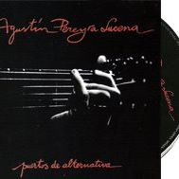
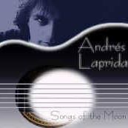


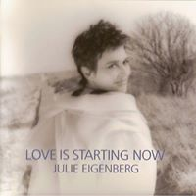
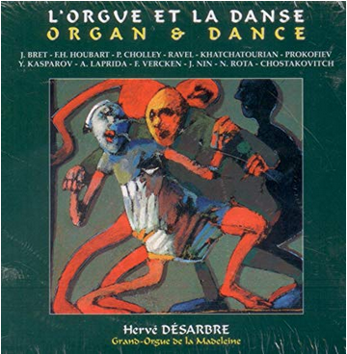
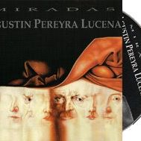
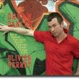
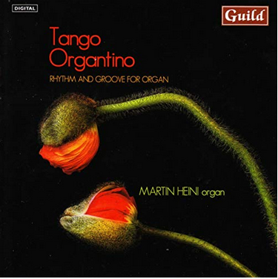
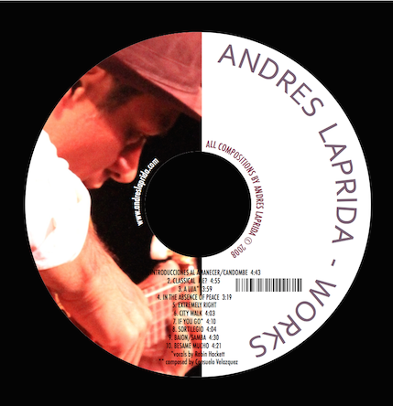

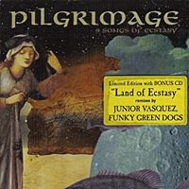

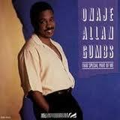
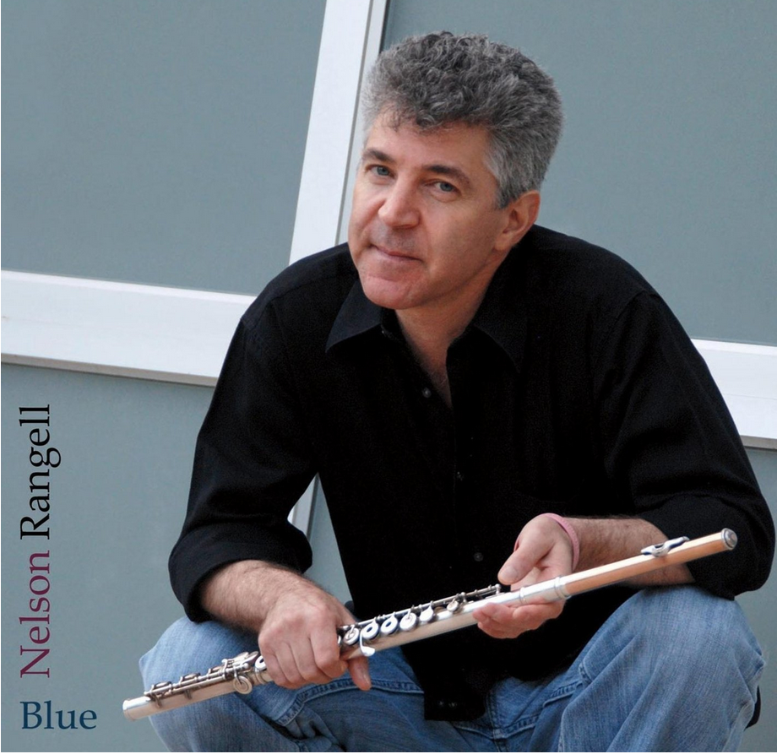
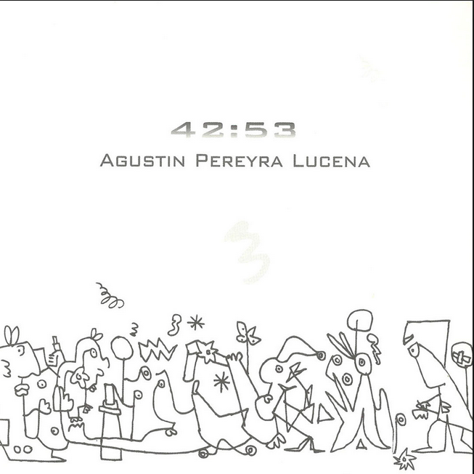
CD RECORDINGS
IN ADDITION TO HIS OWN CDs —Sortilegio, Songs of the Moon y Works, Laprida has shared recording sessions with Don Alias, Gato Barbieri, Michael Brecker, Randy Brecker, Eric Calvi, Simon Cloquet, Catherine Bott, Anthony Cox, DJ Spooky, Hervé Désarbre, Mark Egan, Julie Eigenberg, Chango Farias Gomez, Robin Hackett, Martin Heini, Onaje Allan Gumbs, Manolo Juarez, New London Consort Orchestra, Pedro Aznar, Alejandro Santos, Leo Sujatovich, Agustín Pereyra Lucena, Nelson Rangell, Guillermo Reuter, Phillipe Saisse, Jaime Torres, Olivier Vernet, Julia Zenko, and more.
Contact: aguamagica@gmail.com

Slide 5

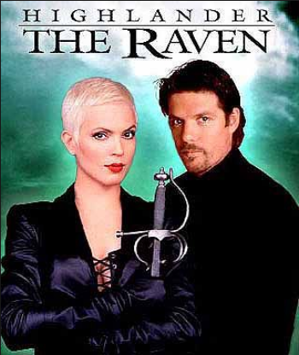

FILM & TELEVISION
Laprida has collaborated with the orginal music of the TV series Highlander, (New York, 2000) and the TV special Euroland II (RAI/Rome, 2002). He also produced the original music of the films Un sueño realizado (Buenos Aires, 1984) and Minas de Ouro Preto (Rio de Janeiro, 1987); the awarded documentary In the Absence of Peace (New York, 1998), the infomercial Ilumina una vida (Lighten a Life, New York, 1990), and One Time (Buenos Aires, 1990).
THEATRE
Original music for the play Sobre el amor, cuentos sobre el amor, with the Academy Award Winner Norma Aleandro at La Mamma theatre, New York, on texts by Federico Garcia Lorca (1985).
Original music for the play Geography of Desire, written and directed by Jaime Sanchez (West Side Story, Serpico, Carlitos Way) performed at Lee Strasberg Actors’ Studio, New York (1989).
Original music for the play Coralia by Pinty Saba (adaptation of the classic La sirenita, by Christian Andersen) at Teatro Las Sillas, Mendoza, Argentina (2018).
Contact: aguamagica@gmail.com

Slide 6




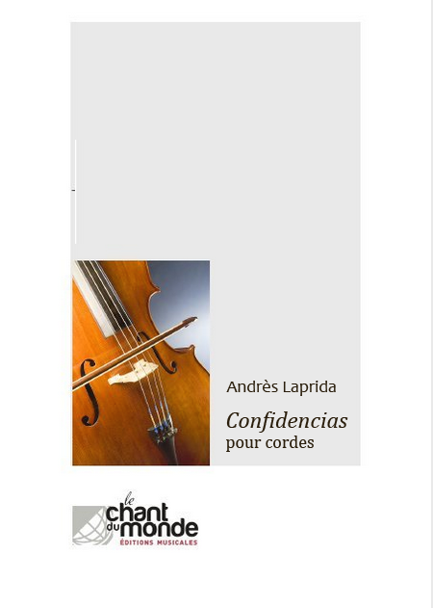
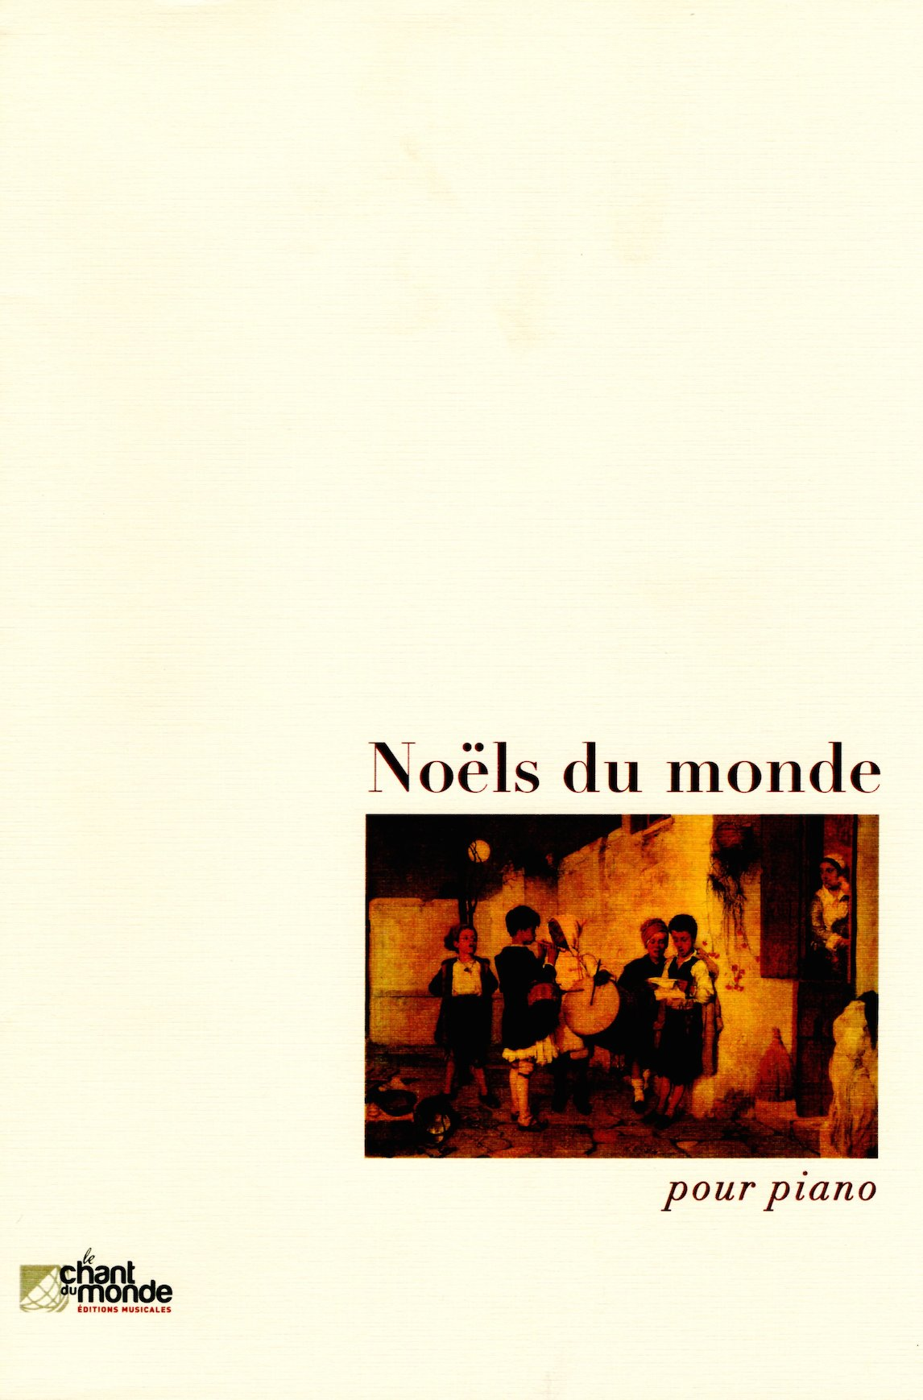
CLASSICAL MUSIC WORKS (LE CHANT DU MONDE)
Laprida has been commissioned, at the moment, seven classical music pieces by the prestigious French publisher Le Chant du Monde.
These works were premiered and published in Europe, as they continue being part of distinguished music programs.
• Florinda (pour grand orgue) Paris, 2004. Organist: Hervé Désarbre.
• Confidencias (pour cordes) Paris, 2004. Ensamble Stringendo. Conductor: Jean Thorel.
• Vanidad de las riquezas (pour orgue, bandoneon et cordes) Paris, 2005. Bandoneon: Guilleume Hodeau,
Organista: Hervé Désarbre, Ensamble: Stringendo, Conductor: Jean Thorel.
• O Carnaval (puor choeur a capella) Paris, 2008. Val de Gráce Choir. Conductor: Etienne Ferchaud
• Samba! (pour grand orgue) Paris, 2011. Organist: Hervé Désarbre
• Variations on Es Ist Ein Ros Entsprungen (pour orgue) Paris, 2013. Organist: Hervé Désarbre
• Noels du Monde (7 petite pièces pour piano) Paris, 2014.
BOOKINGS: aguamagica@gmail.com

Slide 7
CLASSICAL MUSIC PERFORMANCES
STRINGENDO – “CONFIDENCIAS” (dir.: Jean THOREL)
• Eglise Notre Dame du Val de Grâce, Paris
Hervé DERSARBRE – ”FLORINDA”
• Eglise Notre Dame du Val de Grâce, Paris, FRANCE
• Eglise Saint-Roch, Paris, FRANCE
• Eglise La Madelaine, Paris, FRANCE
• Festival d’orgue de Moscou, RUSSIA
• St.-Wolfgang-Kirche, Reutlingen, GERMANY
• Chelsea Art Festival, London, ENGLAND
“VARIATIONS ON ES IST EIN ROS'ENTSPRUNGEN”
• Eglise Saint Ambroise, Paris, FRANCE
Olivier VERNET – “FLORINDA”
• Cathédrale St-Pierre, Genève, FRANCE
• Festival de Laon, Laon, FRANCE
• Eglise Saint-Léger, Cognac, FRANCE
• La Roche-sur-Yon, Nantes, FRANCE
• Basilique Saint Nicolas de Nantes, FRANCE
• Kathedrale von Genf, Geneva, SWITZERLAND
• Dannemarie, FRANCE
• Roquevaire Internationalen Orgelfestival, FRANCE
• Caen, FRANCE
• Kathedrale von Annecy, FRANCE
• Eglise Saint-etienne Du Mont, FRANCE
• France Télévisions (salle Olivier Messiaen), FRANCE
• Stansstad, Nidwalden, SWITZERLAND
• Trinity College Organ Series, USA
• NPR National Public Radio, Program # 0616, USA
• Mariehamn, S:t Görans kyrk, FINLAND
• Salle Philarmonique, Lüttich, FRANCE
• Salle Philarmonique, Liege, FRANCE
Jeremy CULL – “FLORINDA”
• Reid Memorial Church, Edinburgh, SCOTIA
• Palmerston Place Church, Edinburgh, SCOTIA
Eberhard SCHULZ – ”FLORINDA”
• Kirche St. Michael, Schwäbisch Hall, GERMANY
Julien GIRARD – “FLORINDA”
• Abbatiale De Souillac, Midi, Pyrenées, FRANCE
Ainhoa BARREDO – “FLORINDA”
• Durangoko Orfeioa – Orfeón Durangué, SPAIN
• Palacio Euskalduna. Bilbao, SPAIN
Irène RANDRIANJANAKA – “FLORINDA”
• Cathedrale Saint Pierre, Montpellier, FRANCE
Jochen Lewitz – “FLORINDA”
• Konzertkirche Neubrandenburg, GERMANY
Martin Olsson – “FLORINDA”
• S:ta Ragnhilds kyrka, Södertälje, SWEDEN
Fabrice MULLER – “FLORINDA”
• Echternach, LUXEMBURG
Alberto SALIMBENI – FLORINDA
• Notte D’Oro, Ravenna, ITALY
Engelbert SCHOEN – FLORINDA
• Saint Etienne, Caen, FRANCE
Tobias SKUBAN – FLORINDA
• Himmelfahrtskirche Sendling, Munich, GERMANY
CHOIR du VAL DE GRACE– “O CARNAVAL”
(dir.: Ettiene FERCHAUD)
• Eglise Notre Dame du Val de Grâce, Paris , FRANCE
STRINGENDO, Hervé DESARBRE, Guilleume HODEAU –
“VANIDAD DE LAS RIQUEZAS” (dir.: Jean THOREL)
• Eglise Notre Dame du Val de Grâce, Paris, FRANCE
Johan HERMANS– “FLORINDA”
• DZIEŃ PIĄTY, Poznań, POLAND
Ikuko WELLER – “FLORINDA”
• The Temple Square, Salt Lake City, USA
Aarf BERGWERFF – “FLORINDA”
• Laurenskerk, Rotterdam, HOLLAND
Thomas DESERRANNO – “FLORINDA”
• Paroisse Notre-Dame de Laeken, Brussels, BELGIUM
Martin HEINI – FLORINDA
• Stans, Eglise Saint-Pierre-Saint Paul, SUISSE
Roland WINKLER – FLORINDA
• Solingen, GERMANY
Bas VERBOOM – FLORINDA
• Haastrech, HOLLAND
• Gouda, HOLLAND
• Saint John Cathedral, HOLLAND
Eric CORDÉ – FLORINDA / SAMBA!
• St-Croix de Saint-Servan, Saint-Malo, FRANCE
• Festival ECHO d’Organ, Normandie, FRANCE
Massimo Andrea VERSILLI – FLORINDA
• Orgel Concerten Roeselare, Roeselare, BELGIUM Daniel COTÉ – FLORINDA
• La Presse, Montreal, CANADA
Patrick HOOPER – FLORINDA
• St. Antonius Abt Kerk, Deendag, NEATHERLANDS
John PARADOWSKI– FLORINDA
• Loyola University, Chicago, USA
• Saint Francis of Assis, Milwaukee, Wisconsin, USA
Domitila BALLESTREROS – FLORINDA
• Santa Croce, Puglia, ITALY
Laurie RYAN – FLORINDA
• Holy Comforter’s Great Hall, Burlington, USA
Contact: aguamagica@gmail.com

Slide 8
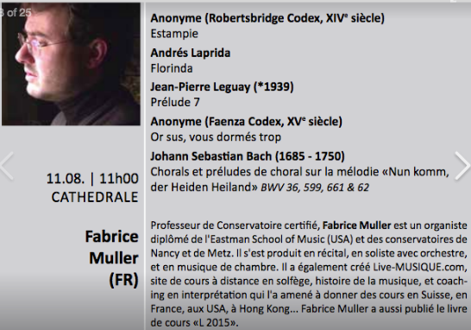

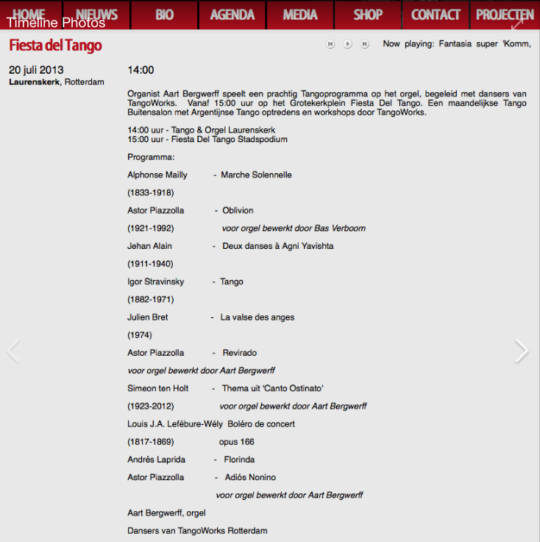

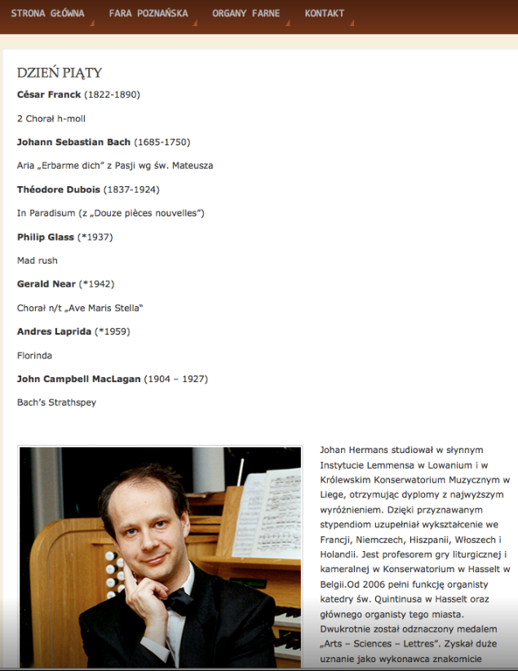
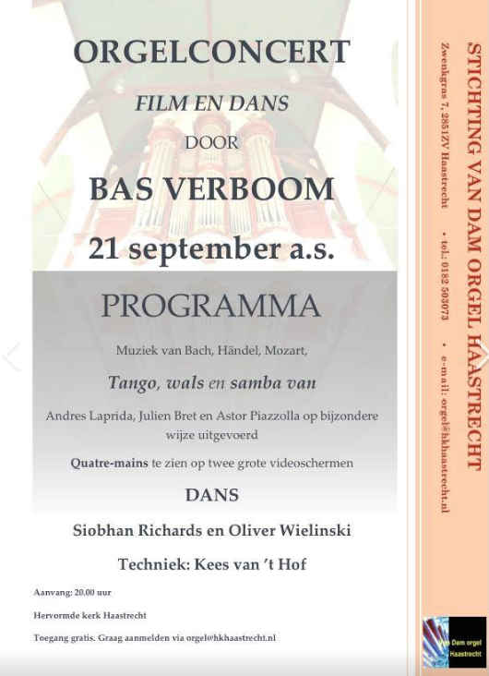
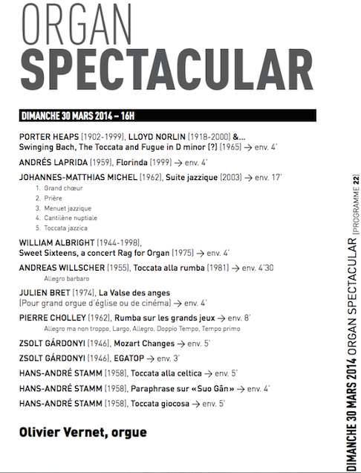

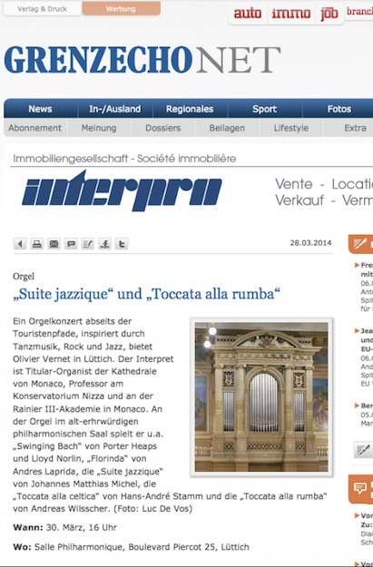
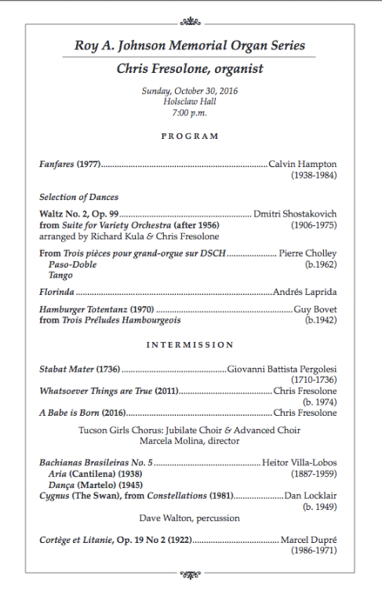
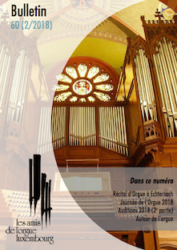
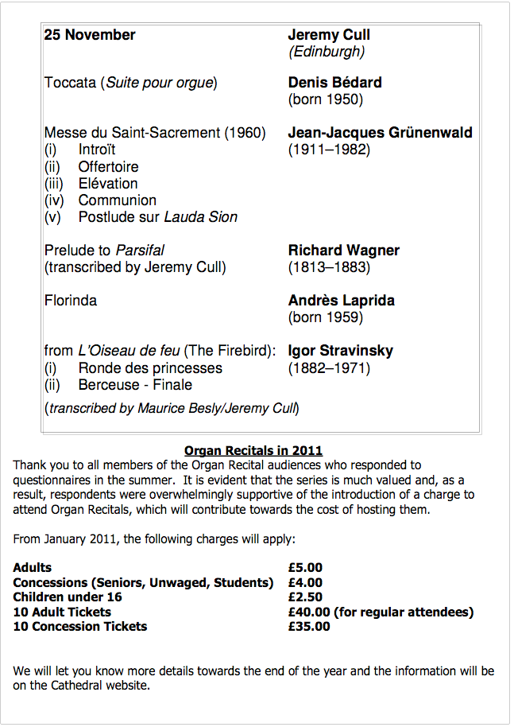
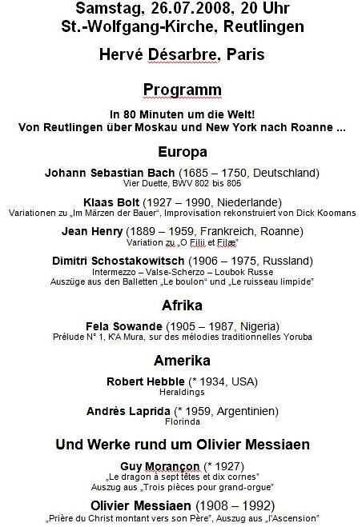
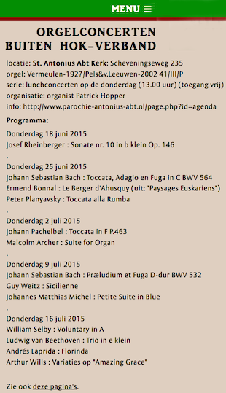
SOME CLASSICAL MUSIC PROGRAMS
Contact: aguamagica@gmail.com

Slide 9
ANDRES LAPRIDA – MUSIC LINKS
Miradas – https://soundcloud.com/andres-laprida/miradas-miracle
Berimbau – https://www.youtube.com/watch?v=q3_FGRNjtYs&list=RDq3_FGRNjtYs&start_radio=1&t=26
A Felicidade – https://www.youtube.com/watch?v=FDAPuuJz5GA
Latino Porteño – https://www.youtube.com/watch?v=Zg39UBhO34o
Variations Sur Es ist ein Ros'Entsprungen (featuring: Hervé Desarbre) – https://soundcloud.com/andres-laprida
A Lua – https://www.youtube.com/watch?v=6P-QIcf0hCY&list=PL9648368AB34529CC&index=7
Caixinha – https://www.youtube.com/watch?v=xVaGhptocmM&list=PL9648368AB34529CC
Bésame Mucho – https://www.youtube.com/watch?v=dSaUmIYBkCA&list=PL9648368AB34529CC&index=13
Vinicius de Moraes, Antonio Carlos Jobim & Andres Laprida – https://www.youtube.com/watch?v=1eaJ9YqVGTQ
The Magician (featuring: Nelson Rangell) – https://www.youtube.com/watch?v=KyU4FkdKkg8&list=PL9648368AB34529CC&index=2
Iberia (from Pilgrimage 9 songs of Ectasy) – https://www.youtube.com/watch?v=leXdVoqy5kY&list=PL9648368AB34529CC&index=5
El Grillo (The Cricket) (Premio Sonora: Una Musica Per il Cinema) – https://www.youtube.com/watch?v=j7igrckOJnA&t=10s
First Time We Met – https://www.youtube.com/watch?v=n_11iBBjeNY&list=PL9648368AB34529CC&index=9
September 11th – https://www.youtube.com/watch?v=lfQ9xk180rw
Vinicius de Moraes 100 Años (featuring: Agustin Pereyra Lucena) – https://www.youtube.com/watch?v=ovYCxR0oLLY
Canto de Ossanha - https://www.youtube.com/watch?v=rFXaKUktCkE
Lila Levinson Presenta – https://www.youtube.com/watch?v=cEEkCghf0GA&list=RDlfQ9xk180rw&index=4
In the Absence of Peace - https://www.youtube.com/watch?v=-zwC3C8JAts
Primeros Arraigos (featuring: Manolo Juarez) – https://www.youtube.com/watch?v=J7PK86vJW5o
Introducciones al amanecer / Candombe – https://soundcloud.com/andres-laprida/introducciones-al-amanecercandombe
Coralia – https://vimeo.com/channels/exagrama/307578468
Sin Ti – (featuring: Julie Eigenberg, Yaron Gershovski (piano), Conrad Korsh (bass) https://www.youtube.com/watch?v=M_MTrQe7ab8
Contact: aguamagica@gmail.com

Slide 10
CLASSICAL MUSIC LINKS
Hervé Désarbre (France)
https://www.youtube.com/watch?v=MwCPYUN9hFU
Martin Olsson (Sweden)
https://www.youtube.com/watch?v=R9k_BfvZ7Ww&app=desktop
Jochen Lewitz (France)
https://www.facebook.com/watch/?v=2189128808078973
Bas Verboom (Netherlands)
https://www.youtube.com/watch?v=UK5mic4oPq0
John Paradowski (United States)
https://www.youtube.com/watch?v=jxreLpXkkRA
Alberto Salimbeni (Germany)
https://www.youtube.com/watch?v=F7BGkVlhimg
Eric Cordé (France)
https://www.youtube.com/watch?v=6ZSCl6QlAug
Patrick Hopper (Belgium)
http://www.parochie-antonius-abt.nl/page.php?id=agenda
Martin Heini (Germany)
https://www.youtube.com/watch?v=I0vyAasggcs
Andres Laprida (Argentina)
https://www.youtube.com/watch?v=lfQ9xk180rw
https://soundcloud.com/andres-laprida
Contact: aguamagica@gmail.com

